Slide 1

DEPARTMENT OF COMPUTER SCIENCE AND ENGINEERING
INTERDISCIPLINARY PROJECT
FOOD EXPIRY TRACKER
PROJECT STUDENT
Botta.Jahnavi
(Reg-43110116)

Slide 2
ABSTRACT
An abstract for a food expiry tracker outlines a system designed to help users monitor and manage the expiration dates of food items, with the primary goal of reducing waste.
The abstract highlights the significant problem of household food waste and proposes a technological solution to address it.

Slide 3
EXISTING SYSYTEM
Existing methods for food expiry tracking range from traditional manual systems to advanced technological solutions, each with distinct features and use cases.
FIFO/FEFO systems: The First-In, First-Out (FIFO) method rotates stock so older items are used first. The more precise First-Expired, First-Out (FEFO) method prioritizes items with.
Visual inspection: People visually check for "use by," "sell by," or "best by" dates printed on packaging. This is the primary method used by most consumers, but the dates can be difficult to read and don't account for external factors like storage conditions.

Slide 4
PROPOSED SYSTEM
Proposed methods for food expiry trackers combine artificial intelligence (AI), Internet of Things (IoT) sensors, and smartphone apps to move beyond manual entry and basic notifications. These integrated approaches offer enhanced features like dynamic shelf-life prediction and real-time spoilage monitoring.
Workflow: A user takes a picture of a product or a grocery receipt with a smartphone. A Convolutional Neural Network (CNN) in the app analyzes the image to classify the food item and uses Optical Character Recognition (OCR) to read the date.
Benefits: This approach is faster and more intuitive than manual typing. Some versions can even recognize food items without clear labels and estimate a shelf life.

Slide 5
ADVANTAGES
About items nearing expiration, users can plan meals around those ingredients, ensuring food is consumed and not thrown away.
Saves money: Fewer spoiled items mean less money wasted on groceries. The tracker helps households get the full value out of every purchase.
Improves meal planning: Knowing what food is about to expire makes it easier to plan meals and encourages creative cooking with ingredients on hand.
Enhances organization: The inventory feature provides a clear overview of all food items, making it easier to see what is on hand and where everything is stores.

Slide 6
DISADVANTAGES
Manual effort: Many tracking apps rely on manual data entry, which can be time-consuming and prone to human error.
Inaccurate automated features: While some apps offer automated solutions like Optical Character Recognition (OCR) for scanning dates, these are often unreliable and may fail to detect dates accurately.
Misleading dates: The "Best By" or "Use By" dates are not always an exact indicator of food safety.
Cost of advanced technology: Systems using RFID or smart refrigerators can be costly, making them inaccessible for many households.
Notes:
Manual effort: Many tracking apps rely on manual data entry, which can be time-consuming and prone to human error.
Inaccurate automated features: While some apps offer automated solutions like Optical Character Recognition (OCR) for scanning dates, these are often unreliable and may fail to detect dates accurately.
Misleading dates: The "Best By" or "Use By" dates are not always an exact indicator of food safety. Users might throw away perfectly good food out of an "ick" factor, leading to unnecessary waste.
Cost of advanced technology: Systems using RFID or smart refrigerators can be costly, making them inaccessible for many households.
Privacy concerns: For smart devices that collect data on food purchasing and consumption habits, there may be concerns over data privacy.

Slide 7
SOFTWARE REQUIREMENTS
User and inventory management
User registration and profiles: Users should be able to create an account with an email address or through third-party sign-in options like Google.
Household sharing : The software must allow multiple users (e.g., family members) to track and view the same inventory, ensuring everyone is aware of food items in the home.
Item entry and inventory display: Users need to be able to add food items to a digital "pantry," "fridge," or "freezer". Each item should display its name, category, quantity, and expiration date
.
Item categorization: The system should automatically or manually categorize food items (e.g., produce, dairy, frozen) to help users find products easily.

Slide 8
HARDWARE REQUIREMENTS
(mid-range household system)
Here’s a hypothetical spec you could aim for:
Single board computer: Raspberry Pi 4 (4 GB RAM)
Camera: Raspberry Pi HQ Camera (12MP) + autofocus lens
Temperature/humidity sensor: DHT22 or BME280
Gas sensor: e.g., MQ-series gas sensor

Slide 9
MODULES
Core modules
These are the foundational components for any food expiry tracker application.
1. Data input module
This module is responsible for capturing information about food items.
Barcode scanner: Uses a device's camera to scan a product's barcode. The system can then use the code to search an external food database to auto-populate product information and potentially a general shelf-life.

Slide 10
MODULE DESCRIPTION
Data input and management: Users can add food items to their digital inventory via several methods, including manual entry, barcode scanning, or photo recognition. This adds the item's name, category, quantity, and expiration date to a database.
Inventory dashboard: The module features a visual dashboard that displays the current stock of food items. Items can be organized into categories, such as fruits, vegetables, or dairy, and often feature color-coded indicators to quickly signal their status.

Slide 11
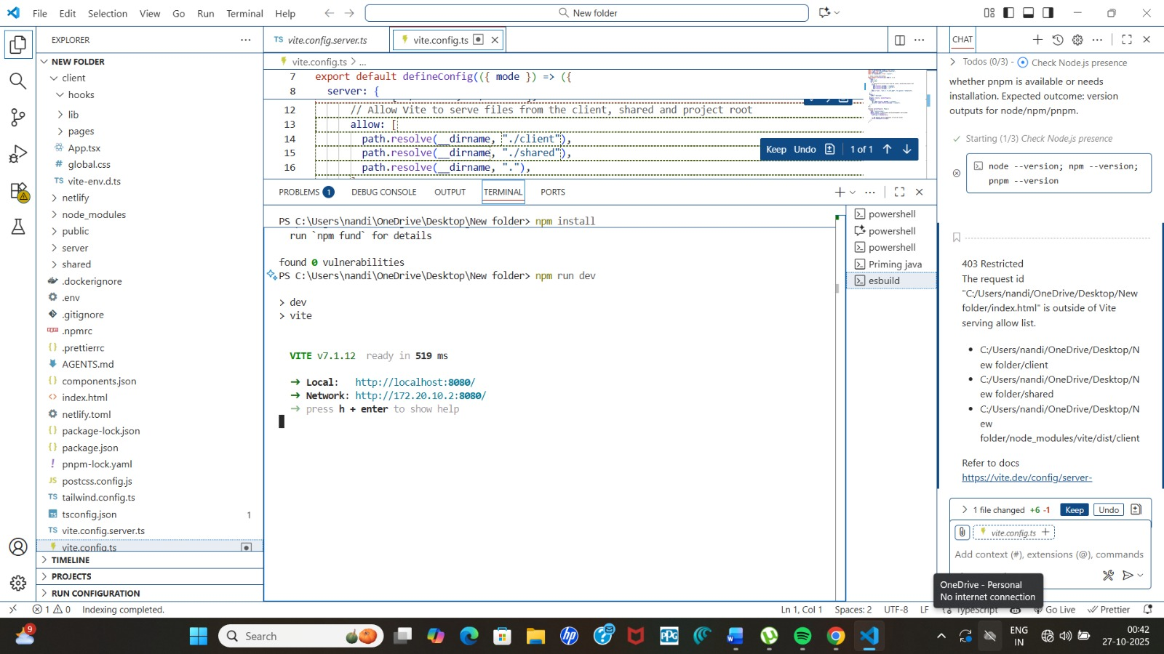
SAMLE OUTPUT

Slide 12
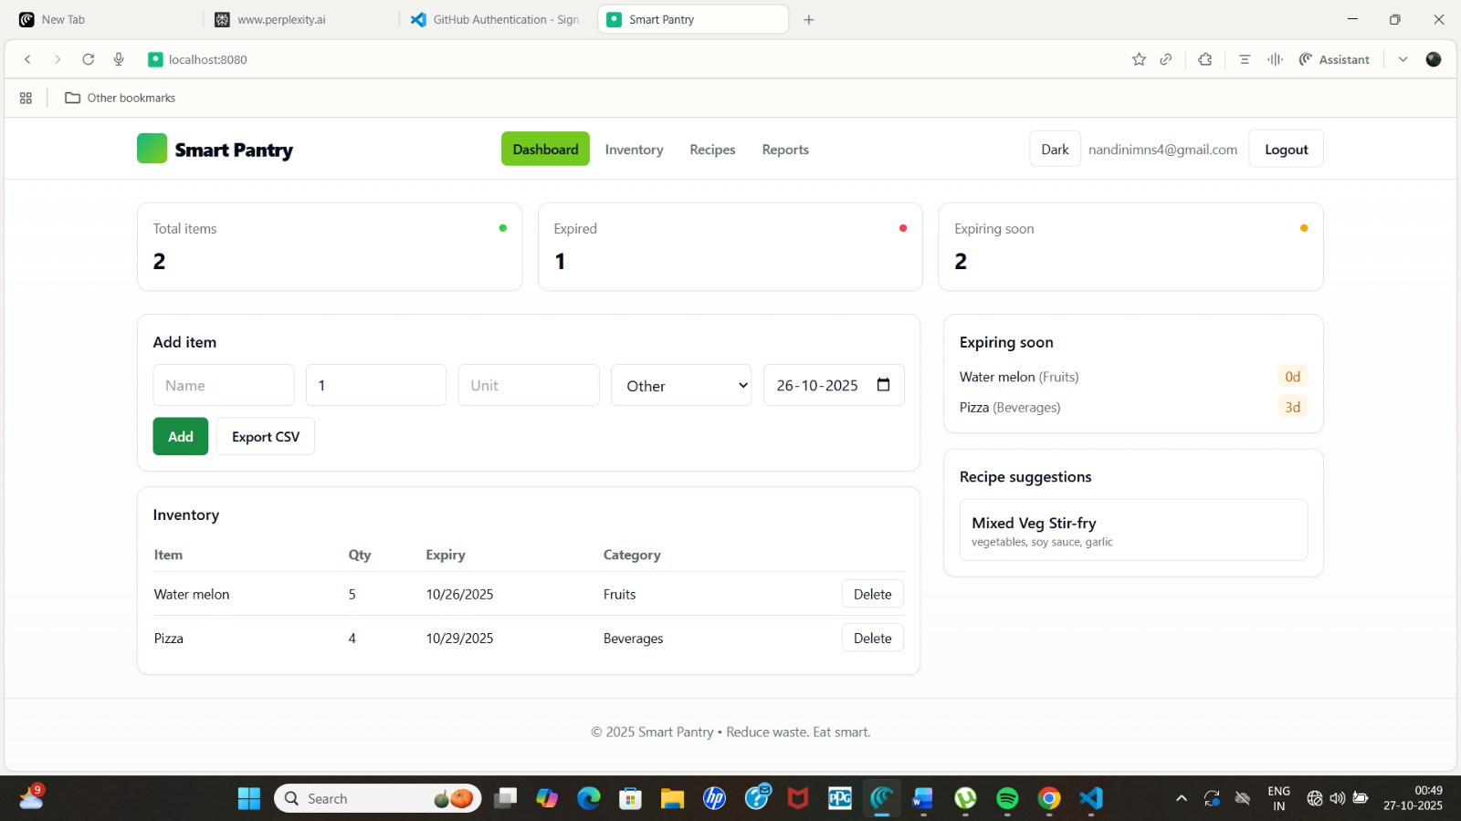
SAMPLE OUTPUT

Slide 13
CONCLUSION
The Food Expiry Tracker provides an efficient and reliable solution to reduce food waste and ensure food safety by monitoring expiry dates automatically. By integrating hardware components such as sensors, cameras, and microcontrollers, the system can identify and track food items, store their expiry information, and alert users before products expire.
This promotes better inventory management and responsible consumption. The project demonstrates how a combination of IoT technology, automation, and smart monitoring can be effectively applied to everyday household and commercial food storage, helping to save money, reduce waste, and promote sustainability.

Slide 14
THANK YOU
We thank God, Our Department, Panel Members, Supportive Professors and all Technical and non Technical staff who helped us in our Project.

